Slide 1
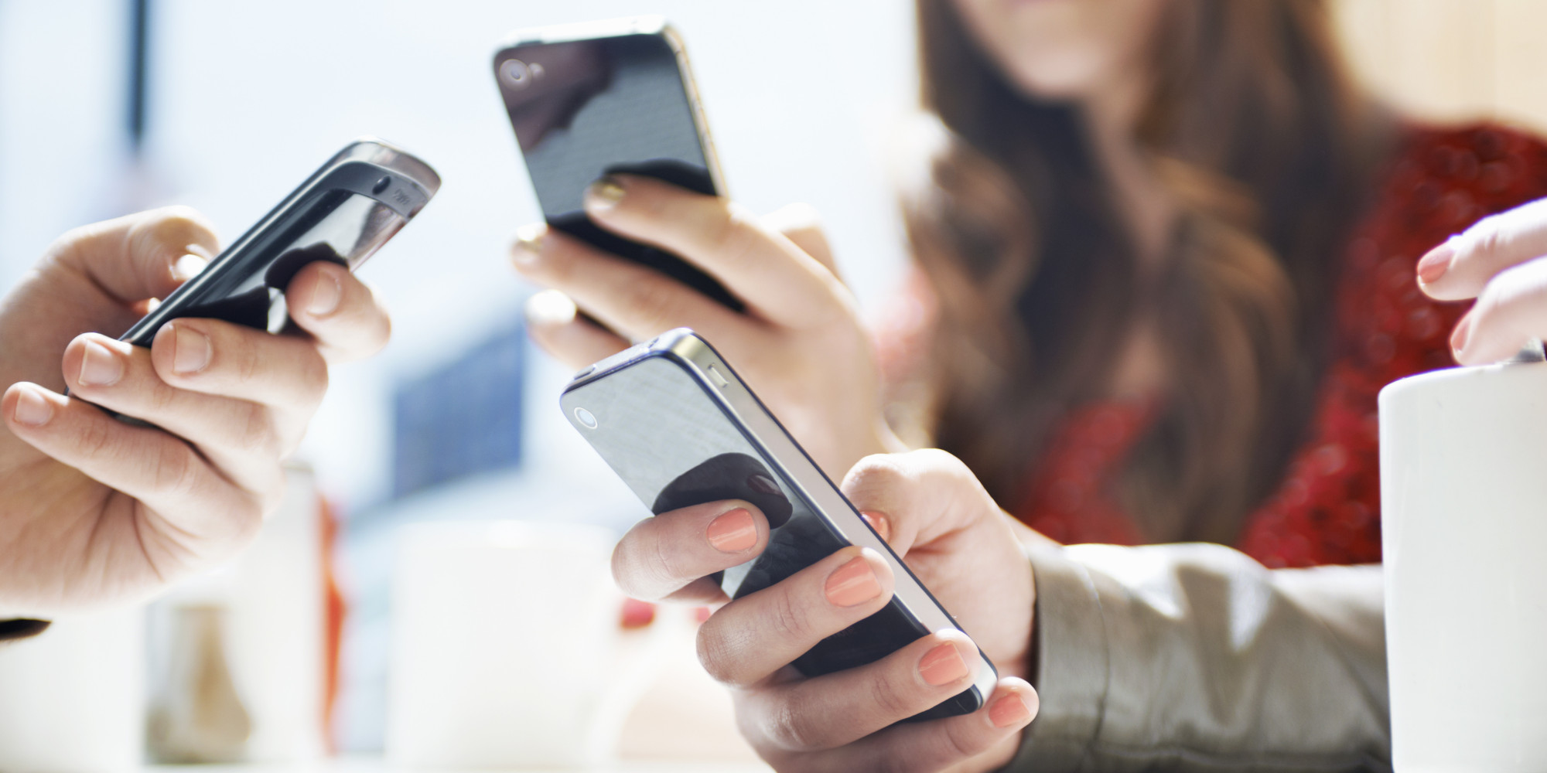
SmartPhone Computing And Applications
Prof. Niloy Ganguly
TAs: Arushi Kesarwani, Sankarshan Mridha, Satadal Sengupta,

Slide 2
What is Mobile Computing?
Today, access to information and computing services is necessary everywhere
not only from our "home base," but also while we are traveling and when we reach a different location.
Mobile computing
Techniques that allow mobile users to use portable computing devices to run stand-alone applications and / or to access remote ones via wireless networks.
A simple definition could be: Mobile Computing is using a computer (of one kind or another) while on the move

Slide 3
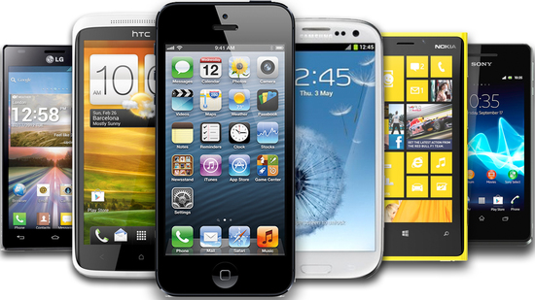
How did everything begin??

Slide 4
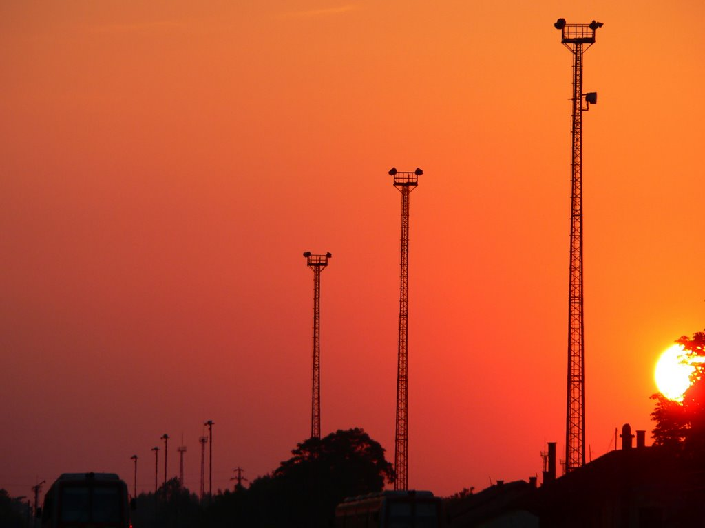
1980s to early 2000:
Consistent innovation in wireless communication

Slide 5
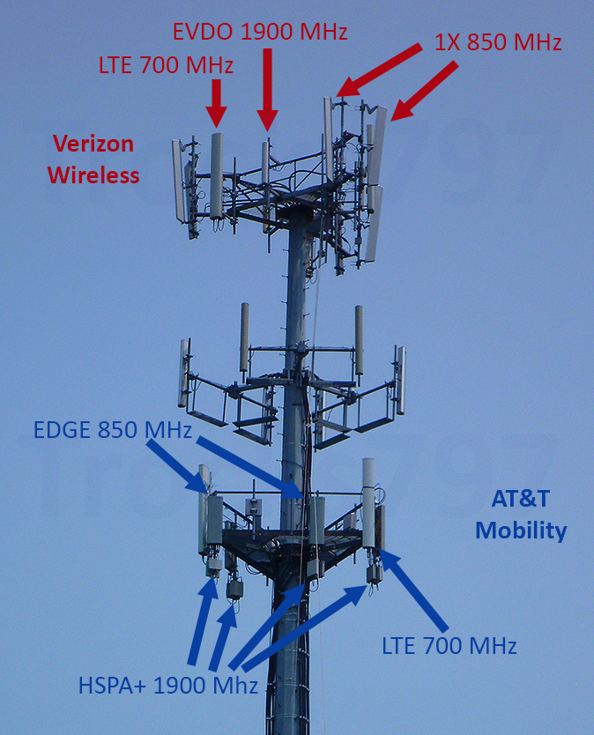
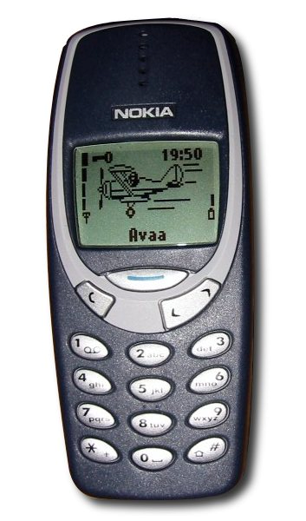
Ubiquitous voice (GSM, CDMA)
Data connectivity coming soon
(2G, 3G, LTE, WiMax, …)
Notes:
Long Term Evolution
Enhanced Voice-Data Optimized

Slide 6
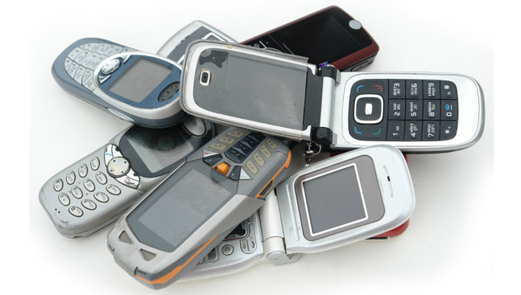
But technology/device easily commoditized
All companies can make them
Long term revenue stream unclear …
Especially big companies with high overheads/cost

Slide 7
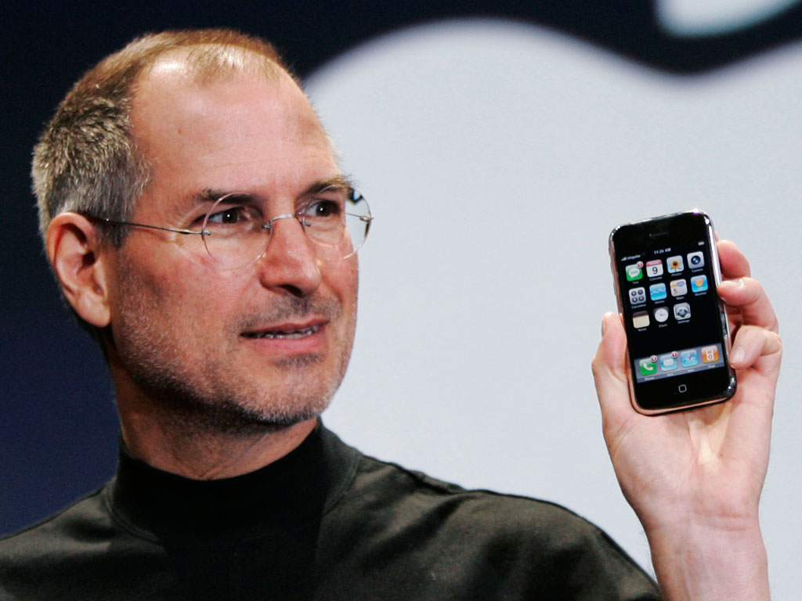
Realization: apps and services are the key
Dynamic eco-system will always keep you ahead
An eco-system that is hard to replicate quick

Slide 8
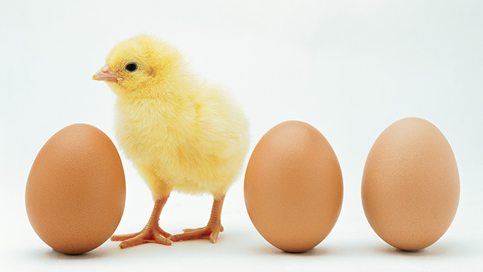
But, always a chicken & egg problem at bootstrap
Developers will not join until proven … will not be proven unless devs. join

Slide 9
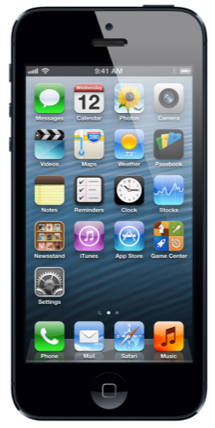
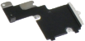
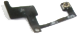
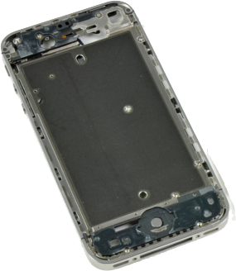
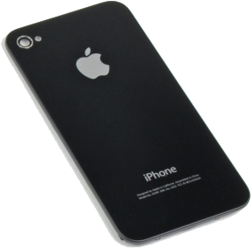
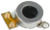
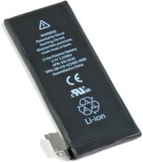
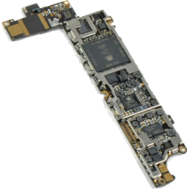
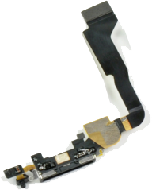
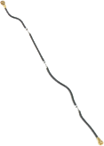
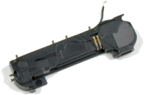
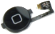
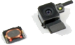
Offer something irresistable
Hardware + CPU + sensors + interface + aesthetics …
To win over app developers and customers

Slide 10
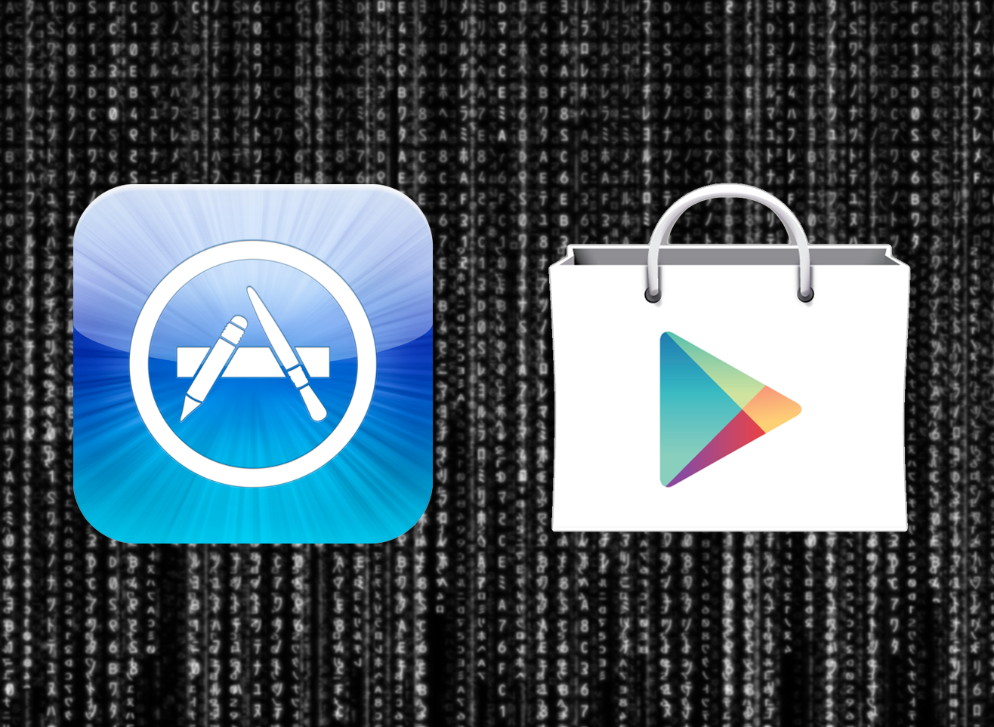
And very importantly, the channel for app development
and delivery – the app store

Slide 11
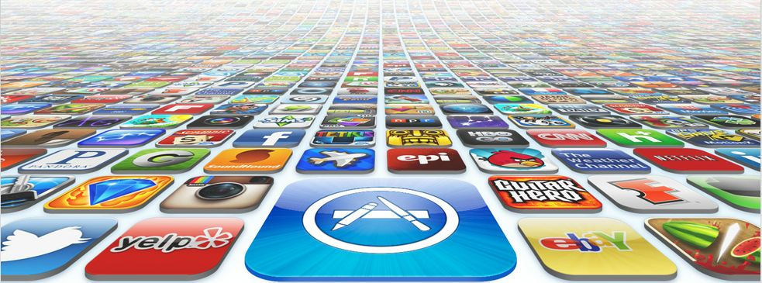
It worked!

Slide 12
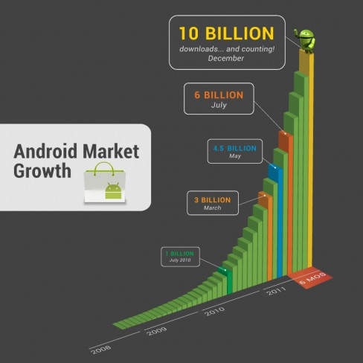
It worked!

Slide 13
But…

Slide 14




Most Apps = Low Hanging Fruit
Recycling the Same Building Blocks

Slide 15

Getting harder to make money off apps
Startups heavily leveraging business innovation
Technological underpins not arriving fast
Cannot sustain for long …
New technology building blocks, ideas, crucial

Slide 16
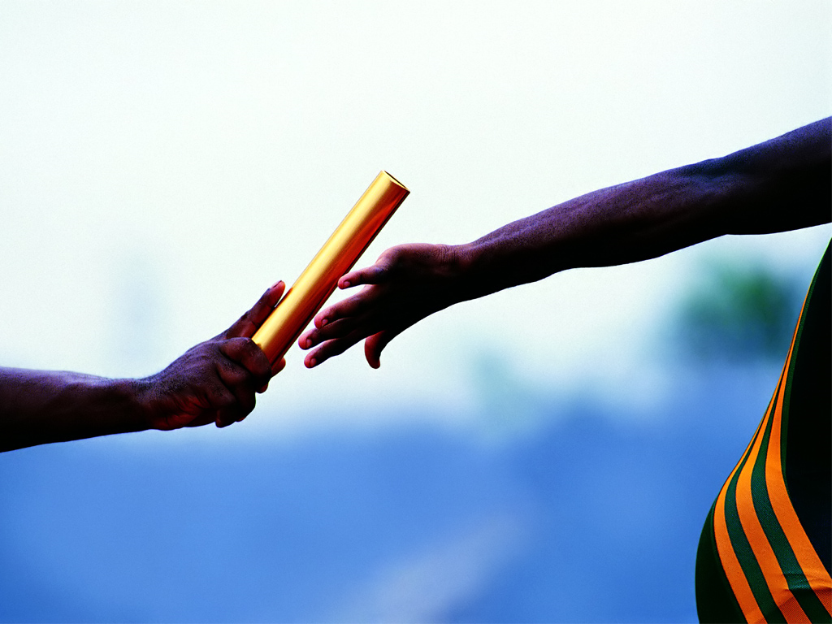
Need you to take it to the next level …
Through fertile imagination, deep research, and execution.

Slide 17
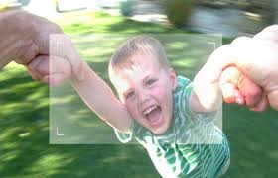
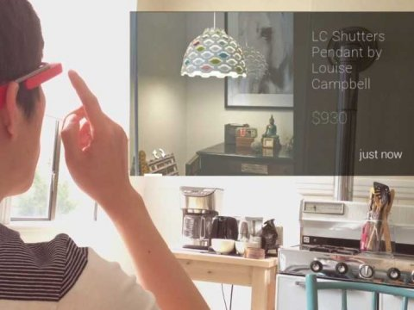
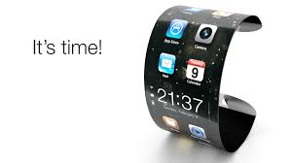
This Course – A First Step Towards …
What should the app store of 2020 look like?
Function of creativity and (inter-diciplinary) techniques

Slide 18
For Example …

Slide 19

Approach
(1) Collect accelerometer, gyroscope and compass readings.
(2) Distinguish “driving” from other activities such as walking, cycling, running, etc.- classification problem.
(3) User-level app/service to intercept and block a call intelligently.
Phone senses owner driving.
Blocks incoming calls

Slide 20
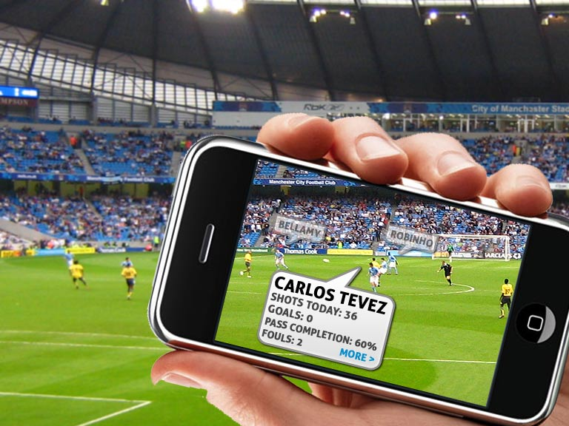
Approach
(1) Real-time person identification (face-recognition) using phone camera.
(2) Pulling up relevant data from the internet using an app/service.
(3) Intelligent information display, preserving visibility and user experience.

Slide 21
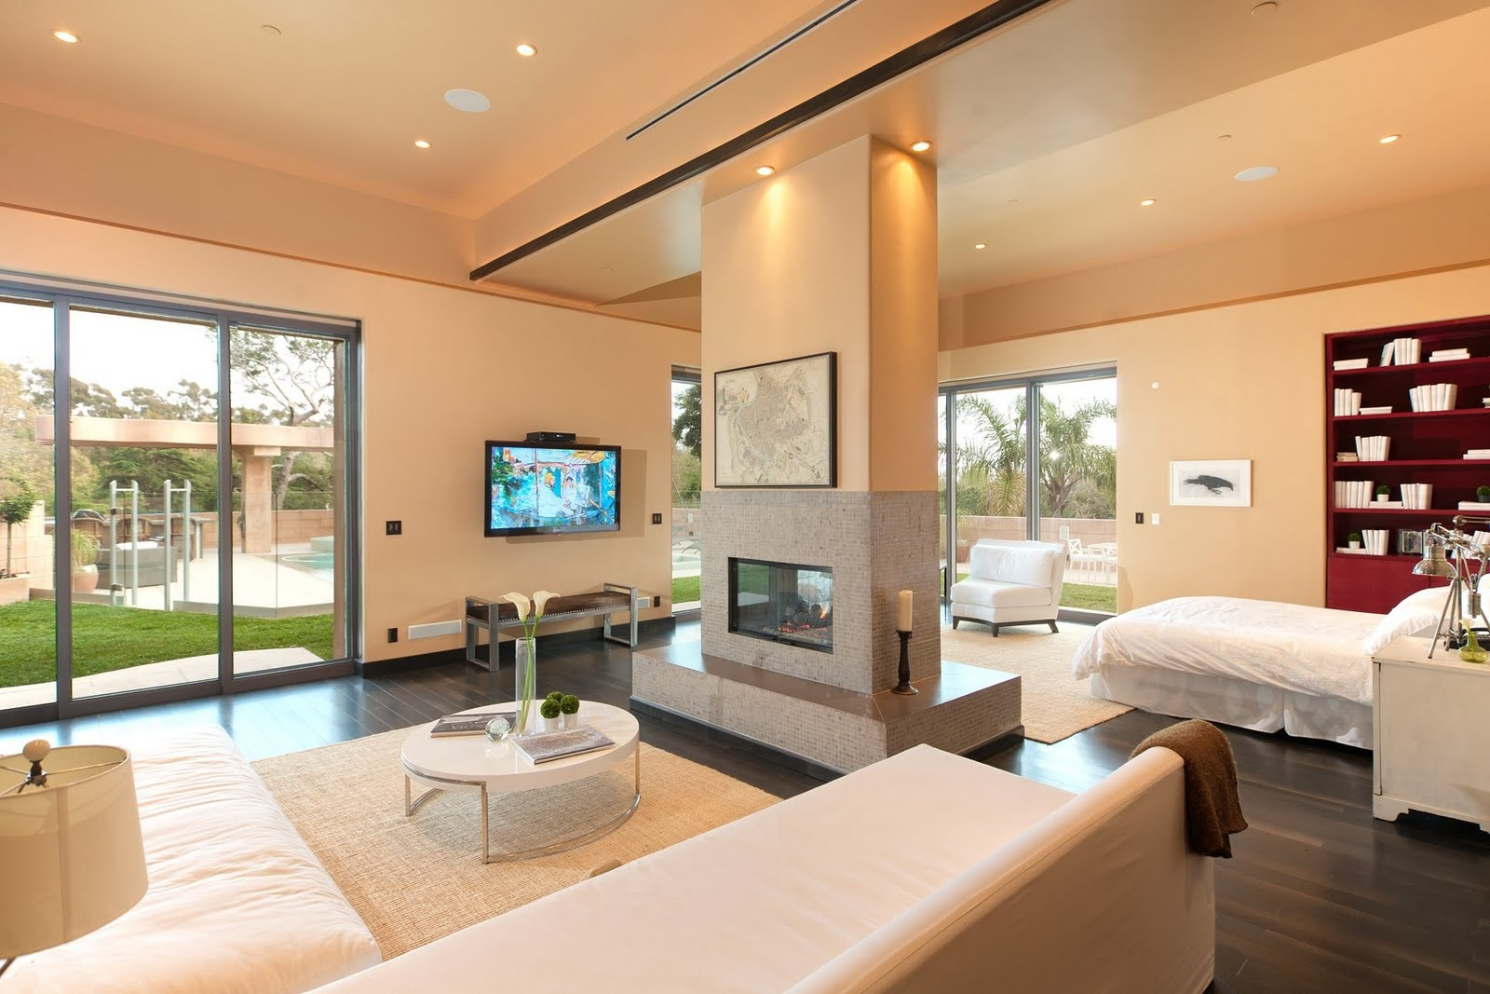
Approach
(1) Indoor localization.
(2) Activity recognition using indoor sensors.
(3) Activity-based automated instruction generation for smart electrical/electronic devices.
Watching TV: diffused light from kitchen
Reading: focussed
bright light here
Cooking: de-focussed
moderate light

Slide 22
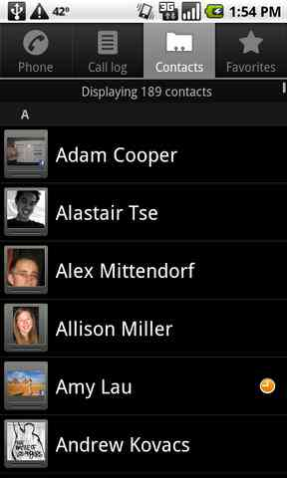
Approach
Movement recognition using phone sensors.
Schedule sensing from calendar/to-do lists.
Location sensing.
Intelligent decision-making.
Busy (Med)
Away
Idle
Idle
Busy (High)
Idle

Slide 23

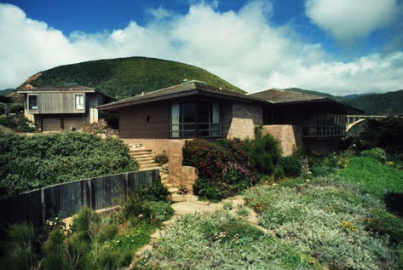

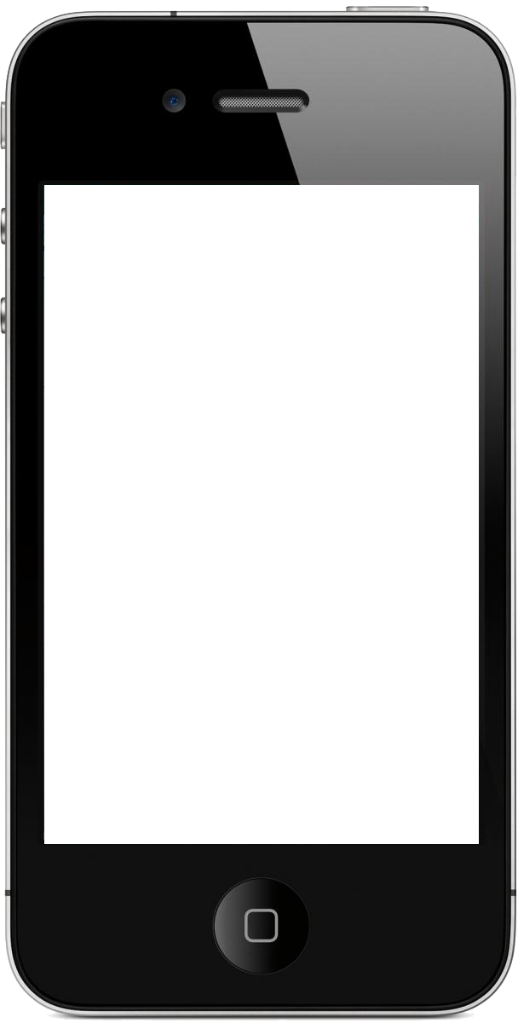
$7.8M
I wonder how much it costs to live there!
36.43, 52.64 → 207 Erwin
Approach
Object recognition using phone camera.
Location sensing at street level.
Fetching price information from internet.
Intelligent display.

Slide 24
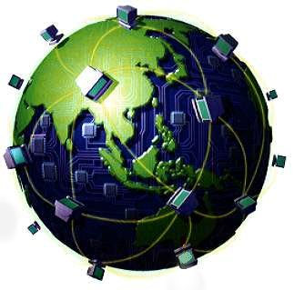
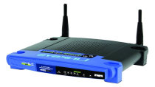
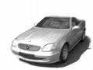
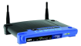



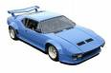
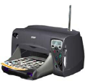
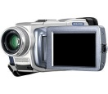

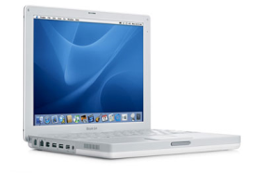
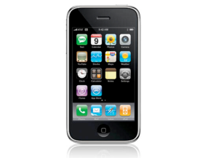
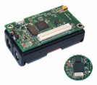

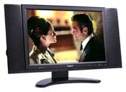

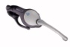
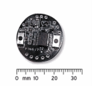
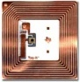
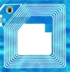
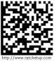
The Future
Internet

Slide 25
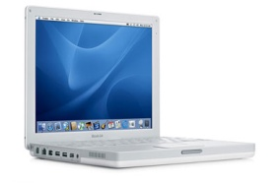

The Future
Microsoft, Intel, Cisco …
Internet
Mesh Networks and
Wireless Backbones
Personal Area
Networks
Motorola, Intel,
Samsung …
RFID and
Sensor Networks
Citywatchers, Walmart
Intel, Philips, Bosch …

Slide 26
Challenges of mobile computing At a Glance
Disconnection
Low bandwidth
High bandwidth variability
Low power and resources
Security risks
Wide variety terminals and devices with different capabilities
Increasing demands for fitting more functionalities into single, smaller device

Slide 27
Challenges of mobile computing
Where do the challenges come from?
Distinct characteristics of mobile and wireless computing:
Wireless communications
Mobility
Mobile devices

Slide 28



Wireless communications
Electromagnetic
waves are produced
and received via
antennas
Transmitting antenna - a transmitter delivers / radiates alternating current into the surrounding environment in the form of radio or microwave signals
Receiving antenna - converts signals from the environment into alternating current and delivers it to the
receiver.

Slide 29
Comparison to Wired Net.
Wired Networks
high bandwidth
low bandwidth variability
can listen on wire
high power machines
high resource machines
need physical access(security)
low delay
connected operation
Wireless Networks
low bandwidth
high bandwidth variability
hidden terminal problem
low power machines
low resource machines
need proximity
higher delay
disconnected operation

Slide 30
Challenges
Wired channel – what if more than one transmitter?
Every user accesses the network by means of a dedicated channel
Switching Center
or
Network Access Point
Dedicated Channel
New user is served by a new wired-line circuit
Access capacity is guaranteed.

Slide 31
Challenges
Wireless channel – what happens?
Wireless users access the network by means of a shared channel
Shared Channel
Base Station
Access capacity is inherently limited.

Slide 32
Mobility - Challenges
Dynamic change of physical locations
Mobile users may use their phones at different places
Dynamic change of logical addresses
Users may use their laptops to access different networks
Frequent change of system configuration
Mobile users may use PDAs with cellular networks when outdoor and with WLANs when indoor.

Slide 33


Mobile devices
Pagers
Cellular phones
Portable media players
Personal digital assistants (PDAs)
Tablet PCs
Laptop computers
Mobile Internet devices (MIDs)

Slide 34











Challenges
Mobile computing devices are becoming smaller, cheaper, more powerful and better integrated
Small screen display size
No keyboard, only some buttons
Small storage capacity
Limited computation capability
Limited battery power
Large variations in design & usage
Frequent disconnection & a short life span

Slide 35
Cope with challenges
Need new solutions to old / new problems to overcome the above constraints
Need to Reduce communication and operational cost
Need to manage mobility
Need to conserve energy
Need to design special interfaces for small devices
Need to enforce wireless security
Mobile wireless networks and protocols
Location tracking techniques
Mobile application architectures
New and innovative applications

Slide 36
Cope with challenges
Need new solutions to old / new problems to overcome the above constraints
Need to Reduce communication and operational cost
Need to manage mobility
Need to conserve energy
Need to design special interfaces for small devices
Need to enforce wireless security
Mobile wireless networks and protocols
Location tracking techniques
Mobile application architectures
New and innovative applications

Slide 37

SmartPhone User Interface

Slide 38

SmartPhone User Interface Design

Slide 39

Good UI Design Principles

Slide 40



Topics to be covered
Introduction
Growth, challenges & future
Android architecture
Sensing
Wireless Energy Management
Energy measurement
Optimizing sensor data acquisition
Reducing energy overhead using traffic shaping, data scheduling
Android Programming
Localization
Methods of location tracking – Radar, GPS, Cell-tower
Low-cost localization using sensors like accelerometer, compass etc.

Slide 41


Topics to be covered
Location Privacy
K-anonymity
Mobile Cloud Computing
How to decide whether & when
to offload job to cloud?
Activity & Gesture Recognition
Alerting drowsy drivers
Mobility
Human mobility models
Collaborative download
Privacy & Security
Privacy Leakage: User profiling from different social networks

Slide 42
Course
Wednesday -12.00 pm-12.55 pm, Thursday- 11.00 am-11.55 am, Friday- 9.00 am – 9.55 am
Webpage: http://www.facweb.iitkgp.ernet.in/~niloy/COURSE/Autumn2014/SmartPhone/index-2015.html
Theory + Project (group of 2/3 students)
Project: (35 Marks)
Choose group-partners & project topic in next 2 weeks
3rd August - 1st Presentation (15 Marks)
7th September - 2nd Presentation (35 Marks)
8th November - 3rd (final) Presentation (50 Marks)

Slide 43
Related journal & conferences
IEEE Transactions on Communications
IEEE Transactions on Parallel and Distributed Systems
IEEE/ACM Transactions on Networking
IEEE Transactions on Vehicular Technology
IEEE Transactions on Computers
Transactions on Mobile Computing
Mobile Networks & Applications
IEEE Communications Magazine
Mobile Computing and Communications Review
Proceedings of the MOBICOM
Proceedings of the MOBIHOC
Proceedings of the INFOCOM
Proceedings of the GLOBECOM
Proceedings of the Vehicular Technology Conference
Proceedings of ICDCS
…

Slide 44
Thank You

Slide 45
BACK-UP

Slide 46


What is mobile computing?
By 2012 the number of mobile subscribers throughout the world will reach 5 Billion, of which close to 1.5 Billion will use wireless communicators (3G) as gateways to the Internet

Slide 47






Evolution of computing paradigm
Personal
Computer
Internet
Mobile
Internet
Mainframe
Client/Server
Fixed Location
Remote Office
Mobile Workplace
Branch
Office
Age of Centralized Computing
Age of Networked
Computing
Age of
Mobile Computing
Age of Distributed
Computing
Age of Personal
Computing
1960
1980
2000
2003
1990
2010
Unwired
Enterprise

Slide 48
Wireless vs mobile
mobile
wireless
Wireless mobile Examples
✗ ✗ stationary computer (with wired LAN)
✗ ✓ notebook in a hotel room (not wi-fi enabled)
✓ ✗ wireless LANs in historic buildings
✓ ✓ Personal Digital Assistant (PDA)

Slide 49








Shifting Trends
The edge of the Internet becoming wireless
Single hop networks
Multi-hop networks

Slide 50
Today’s applications
Corporations
M-business / M-office (working remotely - job dispatch, calendar, email, workflow, etc)
M-commerce (logistics, inventory control)
Consumers
M-commerce (shopping, banking, payment, etc)
Mobile web access / mobile email / SMS
Mobile P2P (file sharing, gaming, etc.)
Government / Public services / Militaries
M-healthcare (emergency with in-time patient condition info.)
Transportation
Tourism (navigation with maps, location-aware travel hints, etc)
Intelligent home
Environment monitoring
Battle field communications

Slide 51
Example
Electronic note-taking
While touring a new city
Where am I? What is this building? How do I get to Lane Avenue? I’m hungry!
Diversion
E-books: stored, downloadable
Games: e.g., chess, solitaire, poker
Ubiquitous communication
email, Web
voice
video

Slide 52
Mobile computing often uses wireless and mobile networks as access technologies.
Wireless and mobile networks extend networking capacity to cover the areas of lack of wired link and support movement of devices
Wireless communication plays an important role in mobile computing. But, mobile computing does not necessarily mean wireless.

Slide 53
Many Benefits due to Wireless
Significantly lower cost
No cable, low labor cost, low maintenance
Ease
Scatter and play
Unrestricted mobility
Unplugged from power outlet
Ubiquity
Available like water/electricity - holy grail
Notes:
What is scatter and play

Slide 54
Enabling factors
Motivations and driving forces
Increasing demands on access to information, communication, and cooperation anywhere, anytime, anyway.
Technology in reality may support such demands
Increasing availability of wireless networks at reduced cost.
Widespread use of handheld devices with increasing computing power and lower cost.
Integration of communication and computing devices (PDA, i-Phone, smart phone, intelligent sensor).
Advances in techniques of detecting location of a device – location based services.

Slide 55


Changing Face of Mobile Devices
Small, powerful, and sensor-embedded
Always with us … always on
Shifting from reactive to proactive computing

Slide 56



Device Vision
Mobile phones
1973: First cellphone call
2007: ~ 3.3 billion mobile phone subscribers
2009: ~ 4.6 billion
Smart phones
are mobile phones
have operating systems
can connect to the internet: web browsing, email, etc
have advanced computing ability: send and receive text & multimedia messages (SMS, MMS), take pictures, etc

Slide 57
Mobile computing means more…
Mobile computing has a close relationship with distributed computing
Distributed computing: coordination of utilizing computing resources shared by multiple hosts over a network.
Mobile computing: extends distributed computing with new dimensions of mobility and wireless connection.

Slide 58
Mobile computing means more…
Mobile computing is also closely related to Internet computing technologies
Mobile computing uses Internet computing technologies
The layered protocol stack and client/server paradigm
Mobile computing allows the application not to connect the network all the time
Mobile Internet, Wireless Internet
HTTP client / server protocols => WAP
XML, HTML => WML, XHTML
J2SE/J2EE, .Net => J2ME/J2EE, .Net Mobile
Notes:
What is internet computing technologies
WAP, WML,XMHTL – needs to be understood
WAP – Wireless Application protocol

Slide 59
But, what does it take for that
mobile/wireless future to become feasible?
Notes:
Why this slide?

Slide 60
Research
Applications that exploit
ubiquity and mobility.
Challenges underlying such
applications
Ubiquitous Services
Incentives
Application
Privacy
Security
Eavesdropping
Loss Discrimination
Transport
Energy Savings
Network
Mobility
Spatial Reuse
MAC / Link
Interference Mgmt.
PHY
Channel fluctuations
Enabling wireless ubiquity.
Showing what is feasible, and
what is not …

Slide 61
Research
Mobile Computing
Ubiquitous Services
Incentives
Application
Privacy
Security
Eavesdropping
Loss Discrimination
Transport
Energy Savings
Network
Mobility
Spatial Reuse
MAC / Link
Interference Mgmt.
PHY
Channel fluctuations
Wireless Networking
Notes:
What is loss discrimination,
What is energy savings in mac layer
Spatial reuse - SRP has a unique bandwidth efficiency mechanism which allows multiple nodes on the ring to utilize the entirety of its bandwidth, this mechanism is called the Spatial Reuse Capability.

Slide 62

Wireless communications
A wireless communication does not use wires (cables) for communications, but by the transmission of electromagnetic waves through ‘the air’.
Michael faraday, James C. Maxwell, Heinrich Hertz
Wireless communication has a long history, started in 1896 - Guglielmo Marconi invented the wireless telegraph
Advances in wireless technology include radio, television, mobile telephone, communication satellites.

Slide 63
Challenges
Wired channel
Wired channel can be easily engineered
Too many noises? – use shell to protect against electromagnetic noise
Large signal attenuation? - use repeaters to amplify the signal
Data rate too low? - upgrade to coaxial cable or optical fiber
Low error rate - Good quality cable: 10⁻⁶; Optical fiber: 10⁻¹¹ ~ 10⁻¹²
Wireless channel
Wireless channel can hardly be engineered
High background noises
Signal strength fluctuates significantly
Low data rate
High error rate – Radio: 10⁻² or worse

Slide 64

Wireless Vision: ubiquitous communication
Notes:
IEEE 802.16 – WiMAx IEEE 802.16

Slide 65
Challenges due to Wireless channel At a Glance
Low and asymmetric bandwidth
High latency
High error rate
Large variation in available bandwidth
Bandwidth differences with orders of magnitude from open-space wireless to indoor wireless
Frequent disconnections
Network failure is common
User’s movement is frequent
Shared radio channel
Increased security risks
Notes:
Why is there large variations? RSSI

Slide 66

Challenges
Location dependency
Location management problem: How does the network know where the intended recipient of a message is currently located?
Cellular scenario
Where is 97532468?
Send broadcast messages from every base station.

Slide 67

Wireless: Convergence

Slide 68

Pervasive Internet of “Things”…
The Economist, April 28, 2007

Slide 69
Course Content (see webpage)
Overview and challenges in mobile computing
Android Programming
Wireless sub-systems and networks
Energy management
Localization
RF based localization
Semantic localization
Effortless, infrastructure-less, energy efficient localizationLocation privacy
Context sensing
Activity and gesture recognition
Mobility
Humans
Privacy and Security

Slide 70
Outline
What is mobile computing?
Mobile computing applications
Challenges in mobile computing
Topics to be covered in this Course

Slide 71
What’s the future picture?

Slide 72
Forthcoming applications
Example: Vehicle Networks
transmission of news, road condition, traffic information, weather, music via DAB
personal communication using mobile phone networks
positioning via GPS
local ad-hoc network with vehicles close-by to prevent accidents, report traffic jams, guidance system, etc
vehicle data (e.g., from busses, high-speed trains) can be transmitted in advance for maintenance
busses, trucks, and trains can transmit logistic information for, e.g., fleet management.
UMTS, WLAN,
GSM,
cdma2000,
DAB, ...
ad hoc
Personal Travel Assistant,
DAB, PDA, laptop,
GSM, UMTS, WLAN,
Bluetooth, ...
Notes:
What is DAB? What is fleet management?

Slide 73
Forthcoming applications
Example: Intelligent life
System knows your current location, and light turns on as you enter a room, and the seat you are sitting on is adjusted to your size.
Your active ID-badge indicates your identity (and your preferences). So brightness can be adjusted also based on your preference.
Music will continue when you leave a room and enter another.
When you enter a range of 5 km of your home, the air-conditioner will be turned on so you get a cool environment upon arriving home.

